Slide 1
Gestion des reservations de ressources informatiques a l’UASZ
Presented by:
Safietou DIALLO
Baye Mor DIOUF
Marième THIAM
El Hadji Abdou DRAME
Licence 3 - Ingénierie Informatique

Slide 2
Ligne directrice
01
02
03
04
PBS
WBS
By Marième THIAM
By Safietou DIALLO
RBS
OBS
By El Hadji Abdou DRAME
By Baye Mor DIOUF

Slide 3
01
Product Breakdown Structure ( PBS )

Slide 4
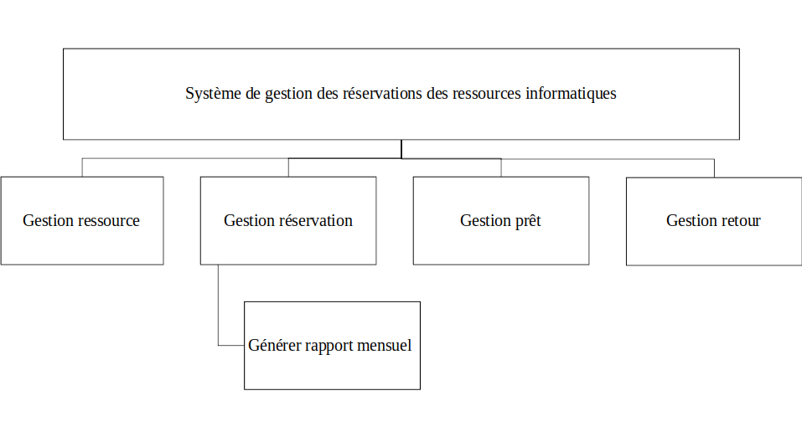

Slide 5
02
Work Breakdown Structure (WBS)

Slide 6
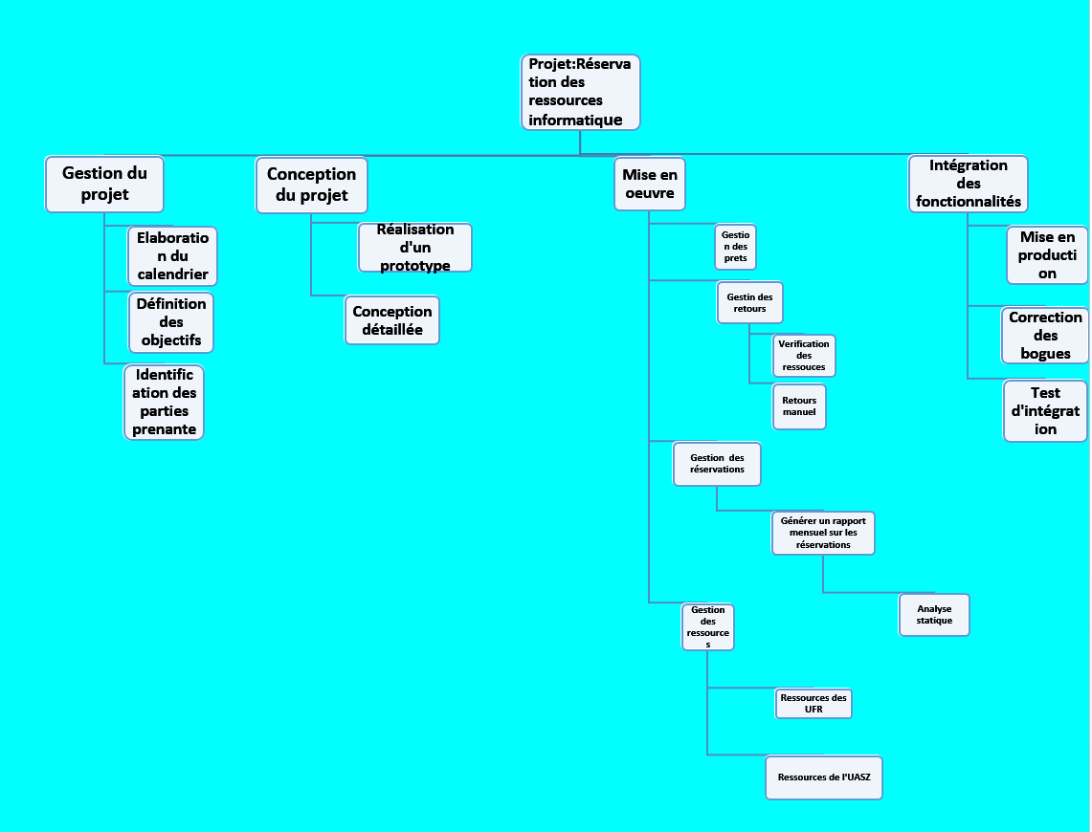

Slide 7
03
Resource Breakdown Structure (RBS)

Slide 8
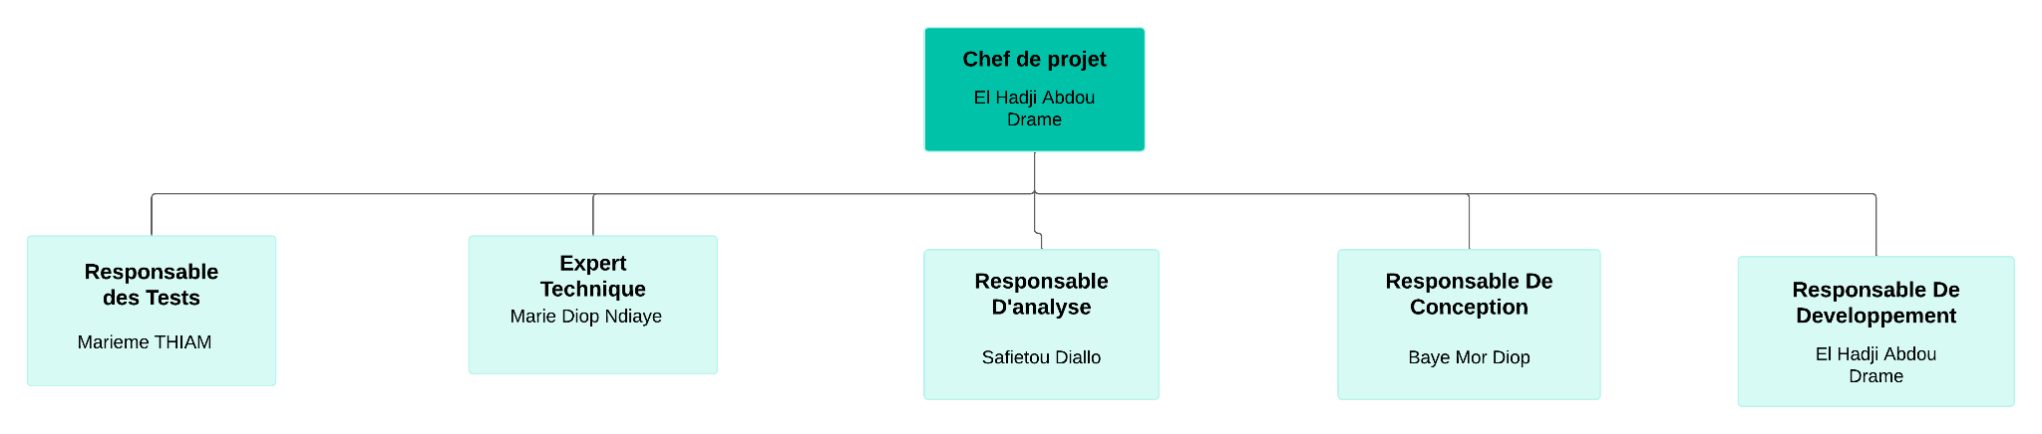

Slide 9
04
Organizational Breakdown Structure
( OBS )

Slide 10
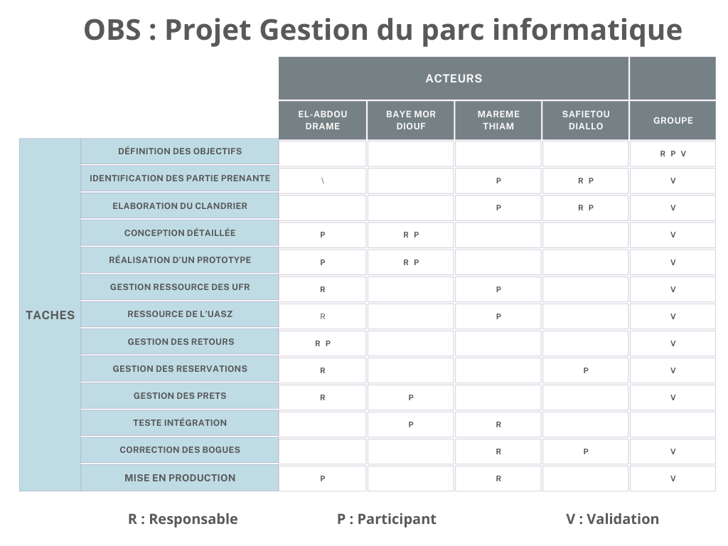

Slide 11
Merci !

